Slide 1
Welcome to
Our Sunday School
We’ll start at 9:07
visit OurSundaySchool.com for more about our class

Slide 2
Today’s class (pages 59-65)
Philippians 1:15-17

Slide 3
Philippians 1:15-17 (CSB)
To be sure, some preach Christ out of envy and rivalry, but others out of good will. These preach out of love, knowing that I am appointed for the defense of the gospel; the others proclaim Christ out of selfish ambition, not sincerely, thinking that they will cause me trouble in my imprisonment.

Slide 4
Today’s class (pages 59-65)
Philippians 1:15-17

Slide 5
Chiasm (from TheGospelCoalition.org)
Chiasm (or chiastic structure) is when an author communicates using symmetry. Chiasms can be as short as a sentence or phrase. Take for instance Hamlet’s famous quip:
(A) “to be
(B) or not
(A’) to be”

Slide 6
Chiasm (from TheGospelCoalition.org)
The term chiasm comes from the shape the corresponding parts form when you diagram them; they look like the left side of the Greek letter chi (Χ). Often, an author’s point hinges on the center of the structure. In our example, the crux of Hamlet’s dilemma is the “or not”—the choice between life or death.

Slide 7
Chiasm (from TheGospelCoalition.org)
Chiasms can also be much longer, shaping an entire narrative, poem, or even book…. Many of us summarize salvation history [as] a chiasm:
(A) Creation
(B) Fall
(B’) Redemption
(A’) Re-Creation

Slide 8
Chiasm (from TheGospelCoalition.org)
In the overarching narrative of Scripture, we see why chiasms are sometimes called ring structures. They give us a feeling of completion—of coming full circle, from creation to re-creation.

Slide 9
The Chiastic structure of John Milton’s Paradise Lost (from Wikipedia)
A: Satan’s sinful actions (books 1-3)
B: Entry into Paradise (4)
C: War in heaven (destruction) (5-6)
C’: Creation of the world (7-8)
B’: Loss of paradise (9)
A’: Humankind’s sinful actions (10-12)

Slide 10
The Chiastic structure of Genesis’ Flood Narrative (from Wikipedia)
A: Noah and his sons (Gen 6:10)
B: All life on earth (6:13:a)
C: Curse on earth (6:13:b)
D: Flood announced (6:7)
E: Ark (6:14-16)
F: All living creatures (6:17–20 )
G: Food (6:21)

Slide 11
The Chiastic structure of Genesis’ Flood Narrative (from Wikipedia)
G’: Food (9:3,4)
F’: All living creatures (9:10a)
E’: Ark (9:10b)
D’: No flood in future (9:11)
C’: Blessing on earth (9:12–17)
B’: All life on earth (9:16)
A’: Noah and his sons (9:18,19a)

Slide 12
The Chiastic structure of Genesis’ Flood Narrative (from Wikipedia)
H: Animals in man's hands (7:2–3)
I: Entering the Ark (7:13–16)
J: Waters increase (7:17–20)
X: God remembers Noah (8:1)
J’: Waters decrease (8:13–14)
I’: Exiting the Ark (8:15–19)
H’: Animals (9:2,3)

Slide 13
Philippians 1:15-17 (NA28)
①⑤ τινὲς μὲν καὶ διὰ φθόνον καὶ ἔριν, τινὲς δὲ καὶ δι’ εὐδοκίαν τὸν Χριστὸν κηρύσσουσιν·①⑥ οἱ μὲν ἐξ ἀγάπης, εἰδότες ὅτι εἰς ἀπολογίαν τοῦ εὐαγγελίου κεῖμαι, ①⑦ οἱ δὲ ἐξ ἐριθείας τὸν Χριστὸν καταγγέλλουσιν, οὐχ ἁγνῶς, οἰόμενοι θλῖψιν ἐγείρειν τοῖς δεσμοῖς μου.

Slide 14
Philippians 1:15-17 (NA28)
①⑤ τινὲς μὲν καὶ διὰ φθόνον καὶ ἔριν, τινὲς δὲ καὶ δι’ εὐδοκίαν τὸν Χριστὸν κηρύσσουσιν·①⑥ οἱ μὲν ἐξ ἀγάπης, εἰδότες ὅτι εἰς ἀπολογίαν τοῦ εὐαγγελίου κεῖμαι, ①⑦ οἱ δὲ ἐξ ἐριθείας τὸν Χριστὸν καταγγέλλουσιν, οὐχ ἁγνῶς, οἰόμενοι θλῖψιν ἐγείρειν τοῖς δεσμοῖς μου.

Slide 15
A: ①⑤ τινὲς μὲν καὶ διὰ φθόνον καὶ ἔριν,
B: τινὲς δὲ καὶ δι’ εὐδοκίαν τὸν Χριστὸν κηρύσσουσιν·
B’: ①⑥ οἱ μὲν ἐξ ἀγάπης, εἰδότες ὅτι εἰς ἀπολογίαν τοῦ εὐαγγελίου κεῖμαι,
A’: ①⑦ οἱ δὲ ἐξ ἐριθείας τὸν Χριστὸν καταγγέλλουσιν, οὐχ ἁγνῶς, οἰόμενοι θλῖψιν ἐγείρειν τοῖς δεσμοῖς μου.

Slide 16
Philippians 1:15-17 (CSB)
①⑤ To be sure, some preach Christ out of envy and rivalry, but others out of good will. ①⑥ These preach out of love, knowing that I am appointed for the defense of the gospel; ①⑦ the others proclaim Christ out of selfish ambition, not sincerely, thinking that they will cause me trouble in my imprisonment.

Slide 17
A: ①⑤ To be sure, some preach Christ out of envy and rivalry,
B: but others out of good will.
B’: ①⑥ These preach out of love, knowing that I am appointed for the defense of the gospel;
A’: ①⑦ the others proclaim Christ out of selfish ambition, not sincerely, thinking that they will cause me trouble in my imprisonment.

Slide 18
Philippians 1:15-17 (CSB)
To be sure, some preach Christ out of envy and rivalry, but others out of good will. These preach out of love, knowing that I am appointed for the defense of the gospel; the others proclaim Christ out of selfish ambition, not sincerely, thinking that they will cause me trouble in my imprisonment.

Slide 19
So what?
Literately > literally

Slide 20
Today’s class (pages 59-65)
Philippians 1:15-17

Slide 21
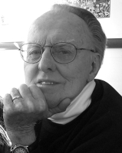
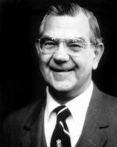
Dr. G. F. Hawthorne & Dr. Ralph P. Martin Although he regrets their motives, he does not reject them.

Slide 22
Today’s class (pages 59-65)
Philippians 1:15-17

Slide 23
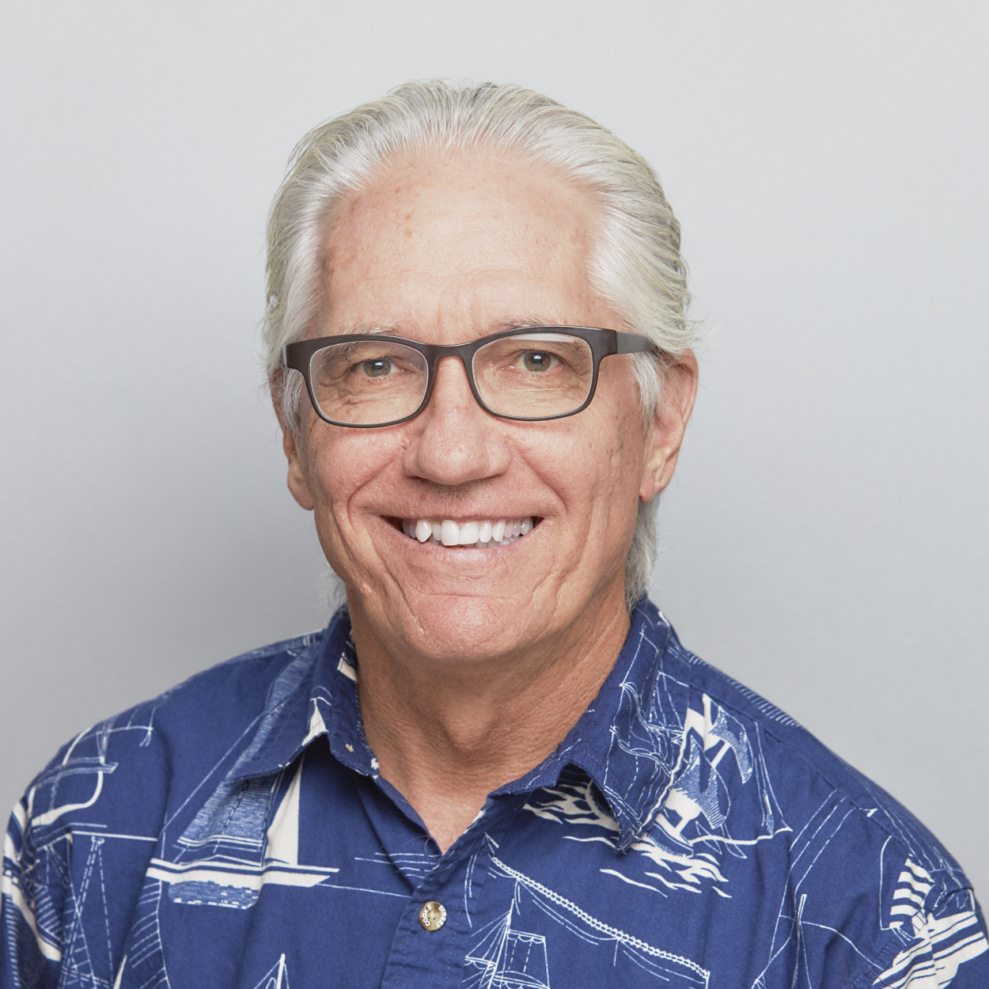
Dr. Joe Hellerman Phthonos is concerned more to deprive another of the desired thing than to gain it. It involves sadness when good things happen to others, joy at the evils they experience…

Slide 24
Dr. Joe Hellerman —thus the opposite of “rejoice with those who rejoice, weep with those who weep” (Rom 12:15).... Jesus was delivered over to Pilot dia phthonos (Matt 27:18).

Slide 25
Today’s class (pages 59-65)
Philippians 1:15-17

Slide 26
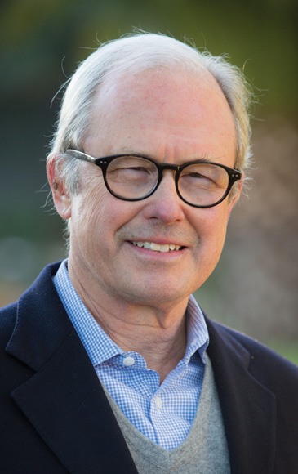
Dr. G. Walter Hansen Envy and rivalry are works of the flesh (Gal 5:20-21) and evidence of a depraved mind (Rom 1:28-29).

Slide 27
Today’s class (pages 59-65)
Philippians 1:15-17

Slide 28
Dr. G. Walter Hansen In his prayer for the Philippians, Paul asks that their love may abound more and more in knowledge (1:9)…

Slide 29
Dr. G. Walter Hansen Now we see an illustration of the way that knowledge increases and guides love.

Slide 30
Today’s class (pages 59-65)
Philippians 1:15-17

Slide 31
Dr. G. F. Hawthorne & Dr. Ralph P. Martin The word has military connotations, like a soldier posted on duty, a thought that would not be lost on readers in a Roman colony.

Slide 32
Today’s class (pages 59-65)
Philippians 1:15-17

Slide 33
Dr. Ralph P. Martin In prison he is enduring hardness as a good soldier of Jesus Christ (cf. 2 Tim. 2:3-4), and as much ‘on duty’ as the guards posted to watch over him are on duty in the service of Rome.

Slide 34
Today’s class (pages 59-65)
Philippians 1:15-17

Slide 35
“BDAG” Found before NT times only in Aristotle, Politics... where it denotes a self seeking pursuit of political office by unfair means.

Slide 36
Today’s class (pages 59-65)
Philippians 1:15-17

Slide 37
Dr. G. Walter Hansen We would like to have more description of these envious preachers to confirm or correct our imagination…

Slide 38
Dr. G. Walter Hansen But we already have more than enough description to challenge our own motivation in preaching.

Slide 39
Today’s class (pages 59-65)
Philippians 1:15-17

Slide 40
Prayer Time
Write down your prayer requests (on the Weekly Update or in the comments)
Lean in, engage, and pray for someone not with you
Go worship

Slide 41
Today’s class (page 16)
Preparing for Philippians 1:1-30
Pray with others
Hear with others
Think with others
Study with others In class, as a table
Share with others
Invite others After class
In class, as a class

Slide 42
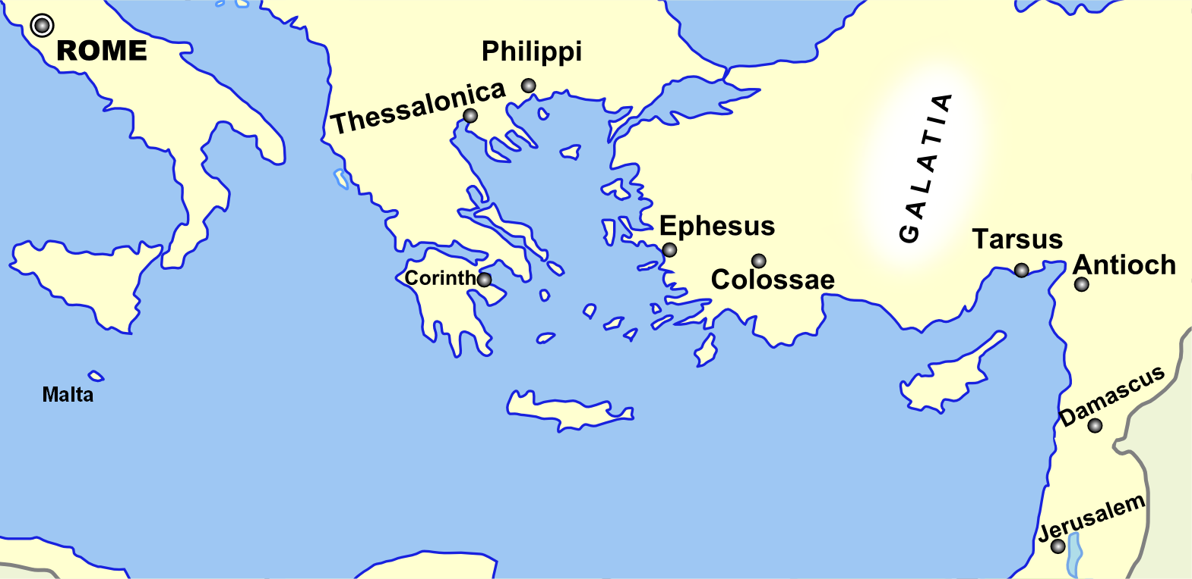
Monozigote. (2012). Broad Overview of Geography Relevant to Paul of Tarsus [Map]. Wikipedia.

Slide 43
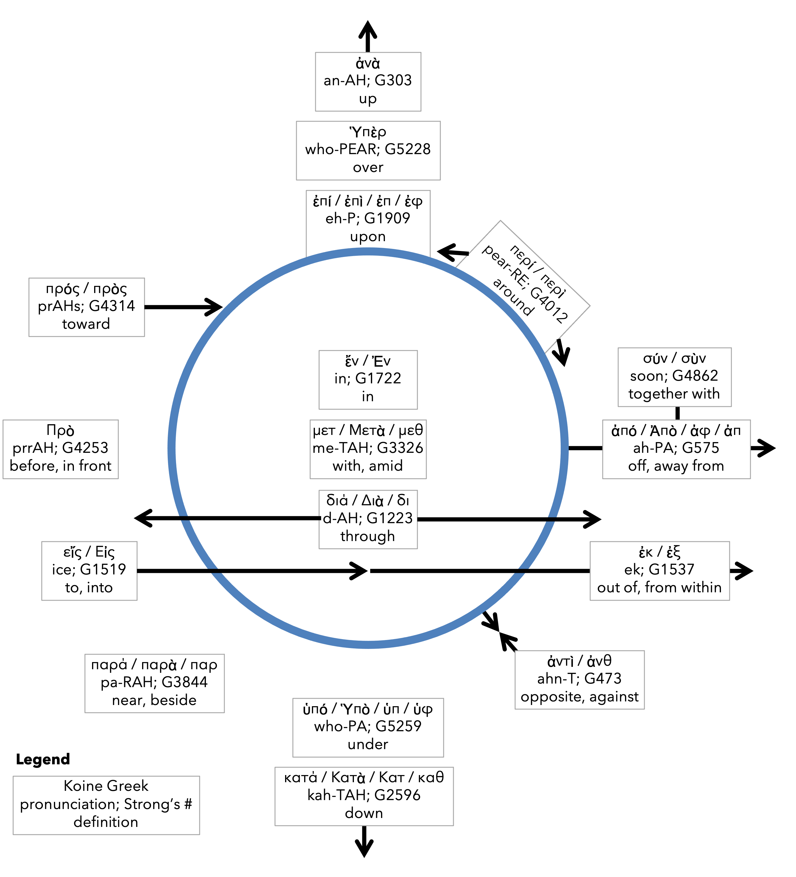
Preposition circle (page 11)

Slide 44
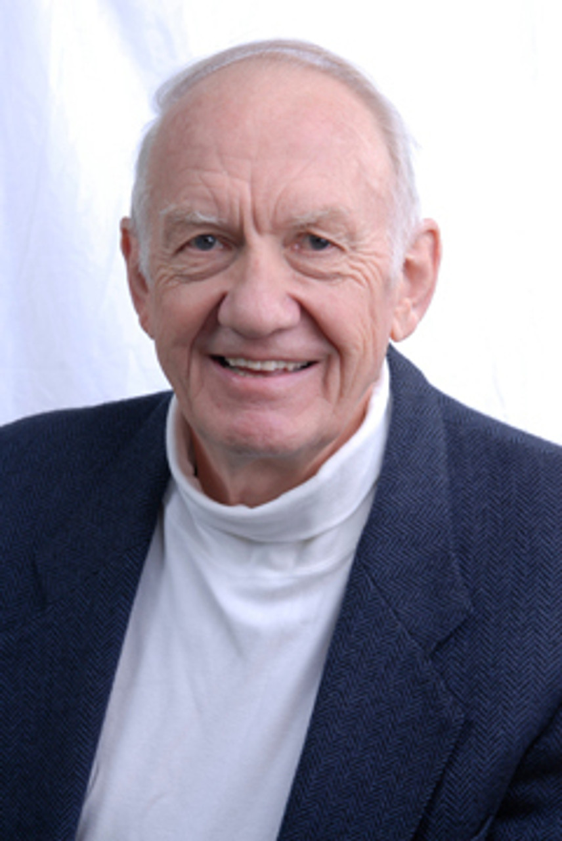
Dr. Gordon Fee …a distinguishable part of the whole, but as part of the whole, not above or outside it

Slide 45
Dr. G. Walter Hansen …a distinguishable part of the whole, but as part of the whole, not above or outside it

Slide 46
Dr. G. F. Hawthorne & Dr. Ralph P. Martin Paul can see it no other way: as the master was, so must the servant be.

Slide 47
Dr. Joe Hellerman The pacification of the known world by the Romans was known as the pax Romana/ Augusta. The ideology of universal peace and prosperity

Slide 48
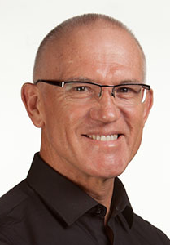
Dr. Mark Keown The pacification of the known world by the Romans was known as the pax Romana/ Augusta. The ideology of universal peace and prosperity under

Slide 49
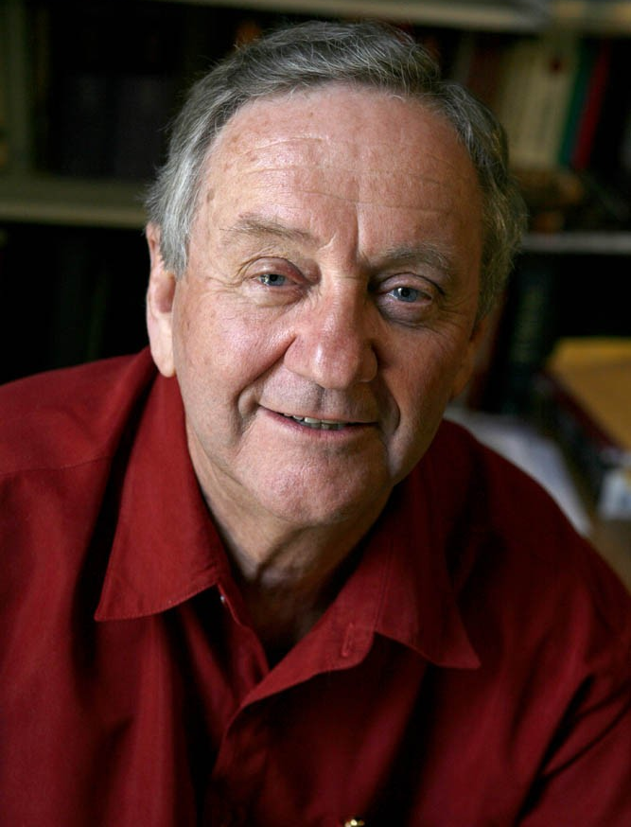
Dr. Peter T. O’Brien The pacification of the known world by the Romans was known as the pax Romana/ Augusta. The ideology of universal peace and prosperity under

Slide 50
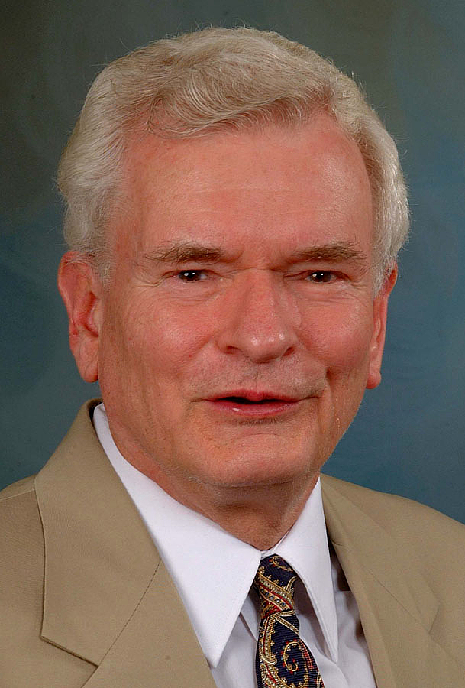
Dr. John Reumann Christ Jesus provides the basis for their relation to God, “glue” for their connections with each other, the sphere for their life and endeavors

Slide 51
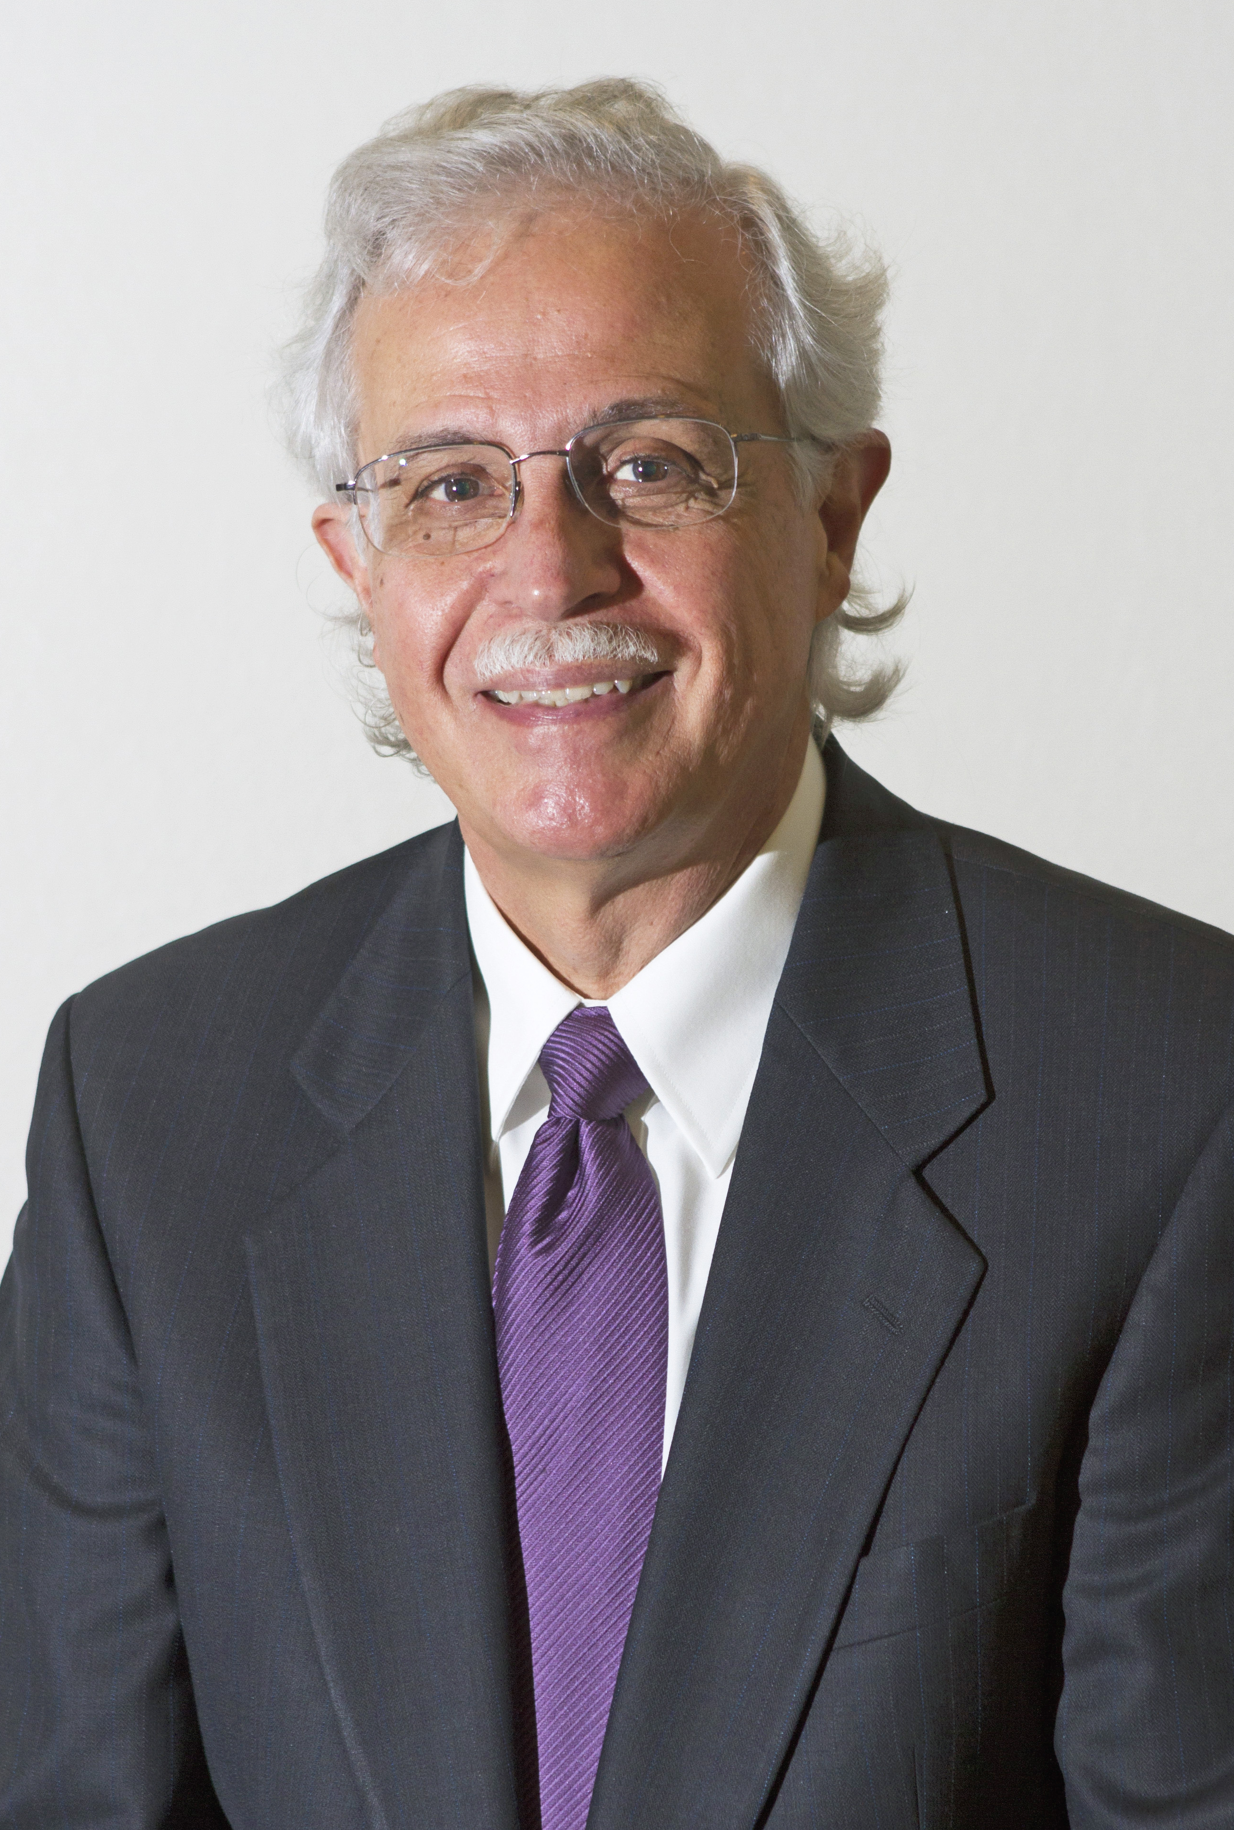
Dr. Moises Silva Christ Jesus provides the basis for their relation to God, “glue” for their connections with each other, the sphere for their life and endeavors

Slide 52
Jen Wilkin The heart cannot love what the mind does not know.

